Slide 1

ISO 14971 and Medical Device Risk Management
Dave Bonnett and Eric Bergman PhD
Notes:
Quick introductions

Slide 2
What is medical device Risk Management (RM)?
Systematic application of management policies, procedures, and practices to the tasks of analyzing, evaluating, controlling and monitoring risk. (ISO 14971:2019)
Primary goal:
Ensure safety and effectiveness
Safety = “Freedom from unacceptable risk”
Secondary goal:
Meet legal requirements from regulatory bodies
Notes:
All devices will have some level of risk. What is “Acceptable” varies from culture to culture and person to person. Device risk has to be considered in the context of the benefits it provides weighed against the risks. The broad definition of “Unacceptable risk” is if the benefits a device provides does not outweigh its risks
Definition of Risk: the combination of the probability of occurrence of harm and the severity of that harm

Slide 3
Scope of medical device RM
In scope
Medical devices
Device portion of a drug/device combination product
Impacts of cybersecurity risks on patient safety
Out of scope
Products not considered medical devices
Drug products and drug product portion of a combination product
Business, Project, and Financial risks
Risk management is an expansive field of which device RM is a subset. There are numerous other standards that govern other types of risk management (e.g., ICH Q9 for drug product RM and ISO 31000 for organizational risk management)
Notes:
Goal is to present a high-level overview of some of the key elements of medical device RM based on ISO 14971 – internationally recognized device RM standard

Slide 4
Key Principles
Device risk management:
Applies to risks to the patient, user, and environment
Is based on the context – the intended use, intended users and intended use environment
Is required throughout the device’s entire lifecycle
Development, manufacturing, storage, distribution, use, service, disposal
Is commensurate with the level of risk to the patient, user, etc.
Is integrated with many other elements of a device quality management system (QMS) including design controls
Is required by regulatory bodies

Slide 5
Regulations, Standards and Guidance
US FD&C Act, Country Laws
MDR (EU)
21CFR820 (US QSR)
ISO 14971, ISO 13485, IEC 60601, IEC 62366-1, IEC 62304, ISO 10993
ISO TIR24971, AAMI TIR57, IEC TIR80002, Numerous FDA Guidance documents
Company Policies and Procedures
Law
Regulation
Standards
Guidance
Procedures
Notes:
How does ISO 14971 fit into the regulatory framework? Standards are voluntary but in general can help implement the intent of the regulations
Note: level of detail generally decreases moving up the triangle. Companies use standards and guidance to inform their policies and procedure to meet the requirements of the regulations and laws.

Slide 6
Relevant Standards & Guidance
ISO 14971:2019 Medical devices - Application of risk management to medical devices
ISO/TR 24971:2020 Medical devices - Guidance on the application of ISO 14971
ANSI/AAMI/IEC 62366-1 Medical devices – Part 1: Application of usability engineering to medical devices
ANSI/AAMI/IEC 62304 - Medical device software - Software life cycle processes
AAMI TIR45 - Guidance On The Use Of AGILE Practices In The Development Of Medical Device Software
ANSI/AAMI/IEC TIR80002-1 - Medical device software - Part 1: Guidance on the application of ISO 14971 to medical device software
Notes:
There are many medical device standards that should be used to help develop safe and effective products. I’ve included a few for reference. Note specifically IEC 62366-1 for the usability engineering process.

Slide 7
Relevant Standards & Guidance
ISO 13485 Medical devices – Quality management systems – Requirements for regulatory purposes
IEC 60601-1 Medical electrical equipment – Part 1: General requirements for basic safety and essential performance
IEC 60601-2-xxx Particular standards for specific devices
ISO 11608-1 Needle-based injection systems for medical use – Requirements and test methods
ISO 10993-1 Biological evaluation of medical devices - Part 1: Evaluation and testing within a risk management process
Notes:
Note the difference between process standards and product safety standards. Process standards define requirements for a process while product safety standards identify hazards/risks and requirements for controlling those risks.

Slide 8
Relevant Standards & Guidance
To search for FDA recognized medical device standards:
https://www.accessdata.fda.gov/scripts/cdrh/cfdocs/cfstandards/search.cfm
For EU harmonized standards:
https://ec.europa.eu/docsroom/documents/48579
FDA Guidance Documents
Notes:
Most standards are voluntary (at least for FDA). However, FDA and other regulatory bodies “recognize” certain standards as “state of the art” and being able to show conformance to a recognized standard reduces regulatory burden for companies. Product safety standards are good sources of hazards and possible controls. Same with FDA guidance documents.

Slide 9
ISO 14971:2019
Recognized by FDA, and EU (in harmonized version)
Required by several other recognized medical device product/process standards (e.g., IEC 60601, IEC 62366-1, IEC 62304)
Provides the basis/framework for a device risk management processes
Notes:
Note that 14971 provides high level requirements for RM but does not specify implementation. It leaves the actual implementation up to medical device manufacturers

Slide 10
RM Process
Key risk management activities from ISO 14971:
Risk management planning
Risk analysis
Risk evaluation
Risk control
Overall residual risk evaluation
Risk management review
Production and post-production activities
From ISO14971:2019 Figure 1
Notes:
14971 is a process standard – defines a standardized RM process framework. Steps in the process are defined in the flow chart. Note that process steps include inputs and generate outputs used in other steps. Also note that RM is iterative and outputs from the process are used in other QMS processes like design controls and human factors (and vice versa). Focus on Risk Analysis, Risk Evaluation, Risk Control, Evaluation of Overall Residual Risk

Slide 11
RM and Usability
Key interactions between the RM process defined in ISO 14971 and the Usability Engineering process from IEC 62366-1
Notes:
Usability (and use error) is a key component of medical device risk management. This diagram taken from 62366-1 shows the interactions between the usability engineering process and the risk management process define in ISO 14971

Slide 12
Definitions
Benefit: positive impact or desirable outcome of the use of a medical device on the health of an individual, or a positive impact on patient management or public health
Harm: Injury or damage to the health of people, or damage to property or the environment
Hazard: Potential source of harm
Hazardous situation: Circumstance in which people, property, or the environment is/are exposed to one or more hazards
Intended use: Intended purpose; use for which a product, process or service is intended according to the specifications, instructions, and information provided by the manufacturer
Life cycle: Series of all phases in the life of a medical device, from the initial conception to final decommissioning and disposal
Reasonably foreseeable misuse: use of a product or system in a way not intended by the manufacturer but which can result from readily predictable human behavior
Residual risk: risk remaining after risk control measures have been implemented
Risk: combination of the probability of occurrence of harm and the severity of that harm
Risk analysis: Systematic use of available information to identify hazards and to estimate the risk
Risk assessment: Overall process comprising a risk analysis and a risk evaluation
Notes:
Definitions from ISO 14971 have been included for reference. Key concepts for analyzing risk are Intended use, Hazard, Hazardous situation and Harm.

Slide 13
Definitions - continued
Risk control: Process in which decisions are made and measures implemented by which risks are reduced to, or maintained within, specified levels
Risk estimation: Process used to assign values to the probability of occurrence of harm and the severity of that harm
Risk evaluation: Process of comparing the estimated risk against given risk criteria to determine the acceptability of the risk
Risk Management File (RMF): Set of records and other documents that are produced by risk management
Safety: Freedom from unacceptable risk
Severity: Measure of the possible consequences of a hazard
Use error: User action or lack of user action while using a medical device that leads to a different result than intended by the manufacturer or expected by the user
Verification: Confirmation, through the provision of objective evidence, that specified requirements have been fulfilled

Slide 14
Risk Analysis
Risk analysis: Systematic use of available information to identify hazards and to estimate the risk
From ISO 14971:2019 Figure C.1
Notes:
This is the process flow diagram from before. Discuss Risk analysis first. Defined as the Systematic use of available information to identify hazards and to estimate the risk

Slide 15
Risk Analysis
Risk Analysis is the process used to identify hazards and to estimate risk. It includes identifying:
The intended use, intended users, and intended use environment of the device*
Reasonably foreseeable misuses of the device*
The characteristics of the device that could impact safety
The Hazards associated with design, manufacturing, and use of the device
Hazardous situations that could arise from the hazards (i.e. how people, property, the environment can be exposed to a hazard)
The resulting harms (i.e. consequences of the exposure to the hazardous situation)
Estimating the risk (i.e., the severity of the harm the probability of the harm occurring)
* Intended use, users and use environment as well as foreseeable misuses are inputs to the risk analysis process from the “Use Specification” - an output of the Usability Engineering process
Notes:
Risk analysis is the “Systematic use of available information to identify hazards and to estimate the risk”
Risk analysis includes several required steps listed here. The first two bullets are inputs to the RA process - generally taken directly from the usability engineering process. Refer to the 14971 – 62366-1 interaction diagram

Slide 16
Risk Analysis: Key Concepts
All risk analysis is based on the device’s intended use, intended users, and intended use environment and must include “reasonably foreseeable misuses” of the device and consider risks arising in in normal and fault conditions
Hazards can be associated with design (including software), manufacturing, and use of the device as well as its distribution, storage and servicing
A hazardous situation occurs when people, property or the environment are exposed to a potential source of harm (hazard) through a sequence of events. (Not all hazards lead to hazardous situations)
An injury (harm) can only occur after exposure to the hazard
A hazardous situation may lead to different harms
Clinical expertise is necessary to identify harms and estimate the consequences of the harms (severity)
Risk analysis starts early during product development and continues throughout the product’s life cycle (iterative)
From ISO 14971:2019 Figure C.1
Notes:
Emphasize: “reasonably foreseeable misuse” and “normal and fault conditions”
and sources of risks – traditionally design, manufacturing and use

Slide 17
Risk Analysis – Sources of hazards
ISO 14971 has a list of potential hazards and examples of hazardous situations
Relevant product safety standards (e.g., IEC 60601-1) will also list hazards
IEC 62366-1 Annex B provides examples of hazardous situations related to usability
Data from similar types of devices/designs should also be evaluated during hazard identification
From ISO 14971:2019 Table C.1
Notes:
Hazard identification is a key step in Risk analysis. Standards are a good source of examples of hazards and hazardous situations. Annex C in 14971 lists categories that many companies use a “checklist” when identifying hazards to be analyzed based on a specific device

Slide 18
Examples of hazards, SoEs, hazardous situations and harms
From IEC 62366-1:2015+A1:2020 Table B.2
From ISO 14971:2019 Table C.3
Notes:
Here are some examples taken from 14971 and 62366. The analysis starts with identification of a hazard – e.g., high voltage, identifies a hazardous situation, the possible harms and a foreseeable sequence of events that could expose the patient to the hazard.
After Hazards have been identified, Sequences of Events, Hazardous situations and potential harms have been identified the next step in Risk Analysis is to estimate the risk.

Slide 19
Risk Analysis - Risk Estimation
Risk estimation is the process used to assign values to the probability of occurrence of harm and the severity of that harm.
Severity
Severity of harm is a continuum that will depend on numerous factors (such as the level of exposure to the hazardous situation, a patient’s pre-existing conditions and co-morbidities)
To simply risk analysis a few discrete levels are generally used to categorize severity using common terms and descriptors appropriate for the medical device
Each harm is assigned a severity level which is determined using clinical/medical expertise and can be based on the reasonable worst-case consequence
The severity rating does not include probability
Examples of common Severity terms and descriptions from ISO 24971:2020 Table 4
Notes:
Recall that risk consists of two parts – severity of harm and the probability that the harm (of a certain severity) occurs. Harm severity and probability are evaluated separately

Slide 20
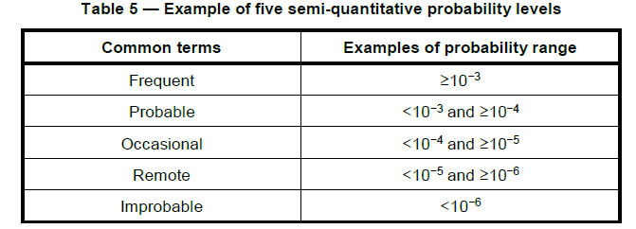
Risk Analysis - Risk Estimation
Probability of Harm
The probability of harm can be either qualitative or quantitative. Qualitative estimates should be used for new products
Like severity, probability is also a continuum and discrete levels are generally used to categorize it
The probability of harm is sometimes broken into two parts – the probability of the hazardous situation occurring (P1) and the probability that the harm of specified severity occurs when the hazardous situation has occurred (P2)
P1 includes elements of the sequence of events that lead to the exposure to the hazard. The individuals assigned to estimate the probability P1 should be familiar with the design, construction, use and servicing of the medical device, as well as have an adequate understanding of the use environment.
Examples of common probability terms and descriptions from ISO 24971
Notes:
Qualitative vs Quantitative: quantitative should only be used when statistically significant probability data exists

Slide 21
Risk Analysis - Risk Estimation
The P2 estimate will include a clinical aspect thus the individuals assigned to estimate P2 should be familiar with the medical use of the device
P2 is often estimated using expert clinical judgment and experience with similar devices, informed by adverse event data, medical literature and information from post-production.
Detailed understanding of the performance of the medical device is generally not needed to estimate P2
Combining the severity of harm and the probability of harm produces the risk estimate
A risk matrix is often used to show the combination of the severity level and the probability of harm level (S x P_{h})
Each Severity x Probability of harm combination is assigned a risk level (e.g., Low, Medium, High) that is then used to evaluate the risk
 |  | Severity of Harm
 |  | Negligible (S1) | Minor (S2) | Serious/ Major (S3) | Critical (S4) | Fatal (S5)
Probability of Occurrence (P_{h}) | Frequent (P_{h}5) | S1P5 Medium Risk | S2P5 Medium Risk | S3P5 High Risk | S4P5 High Risk | S5P5 High Risk
 | Probable (P_{h}4) | S1P4 Medium Risk | S2P4 Medium Risk | S3P4 Medium Risk | S4P4 High Risk | S5P4 High Risk
 | Occasional (P_{h}3) | S1P3 Low Risk | S2P3 Medium Risk | S3P3 Medium Risk | S4P3 Medium Risk | S5P3 High Risk
 | Remote (P_{h}2) | S1P2 Low Risk | S2P2 Low Risk | S3P2 Medium Risk | S4P2 Medium Risk | S5P2 Medium Risk
 | Improbable (P_{h}1) | S1P1 Low Risk | S2P1 Low Risk | S3P1 Low Risk | S4P1 Medium Risk | S5P1 Medium Risk
Notes:
Note: the P1 x P2 approach is not required. This shows an example of a risk matrix and how it’s often used for risk evaluation in the device industry. However, the approach is not required by 14971 although 24971 shows an example. Each manufacturer has to define its own risk estimation process and scales.

Slide 22
Risk Evaluation
Risk evaluation: Process of comparing the estimated risk against given risk criteria to determine the acceptability of the risk
Risk evaluation is used to determine if risk control is required to reduce a risk to an acceptable level
Notes:
After risk has been estimated it must be evaluated. Risk evaluation is used to determine if risk control is required to reduce a risk to an acceptable level, i.e., it’s input to the risk control process step

Slide 23
Risk Evaluation
The criteria used to determine the acceptability of individual risks is defined prior to starting risk analysis
ISO 14971 does not specify risk acceptability criteria since what is acceptable differs by culture, regulatory agencies and even at an individual level. Thus, each medical device manufacturer is required to define its own risk acceptability criteria
Device manufacturers often use the risk levels determined during risk estimation as a starting point for risk acceptability.
Low risks are often deemed acceptable without risk reduction being required
Medium and high risks will require additional action to reduce the risk
Common risk acceptance criteria include:
Risk must be reduced “As far as possible” considering generally accepted state of the art technology
Requirements from relevant safety standards have been implemented
Risk Level | Risk Acceptability | Definition
Low Risk | Acceptable | Residual risk is acceptable and additional risk reduction/risk control measures are not required.
Medium Risk | Broadly Acceptable | Residual risk is broadly acceptable. However, risk reduction should be investigated. Application of “state of the art” risk control measures such as meeting safety requirements identified in applicable standards shall be considered to reduce risk to an acceptable level.
High Risk | Unacceptable | Residual risk is unacceptable and additional risk control measures shall be implemented. If implementing additional risk control measures is not possible a benefit risk analysis must be performed to ensure that the clinical/medical benefits outweigh the residual risk.
Notes:
This is a commonly used approach but is not in 14971. Each device company has to define its own risk evaluation process and risk acceptability. 24971 provides some examples.

Slide 24
Risk Control
Risk control: Process in which decisions are made and measures implemented by which risks are reduced to, or maintained within, specified levels.

Slide 25
Risk Control
Risk Control is a process step in ISO 14971 that includes:
Risk control option analysis
Risk control measure (RCM) implementation
Residual risk evaluation
Benefit-risk analysis (for unacceptable residual risks)
Identifying and analyzing risks arising from risk control measures
Checking completeness of risk control
All risks that do not fall into an acceptable range must be reduced
Risk Control Measures (RCM) are used to reduce risks

Slide 26
Risk Control – Key Concepts
All risks that do not fall into an acceptable range must be reduced
If Risk Reduction is not possible, a benefit-risk analysis must be performed to ensure that the clinical benefits outweigh the risk
Risk Control Measures (RCM) are used to reduce risks
The term “risk control” is often used interchangeably for risk control measures and the ISO 14971 risk control process step
A main focus of device RM should be on reducing identified risks - not in risk estimation
ISO 14971 lists three types/categories of risk control measures:
inherently safe design and manufacture
protective measures in the medical device itself or in the manufacturing process
information for safety and, where appropriate, training to user
Priority should be given to inherent safety risk control measures followed by protective measures and finally information for safety
Multiple risk control measures may be required to reduce a risk to an acceptable level
Testing is not considered a risk control measure under ISO 14971
All RCMs must be implemented and verified to be effective in reducing risk

Slide 27
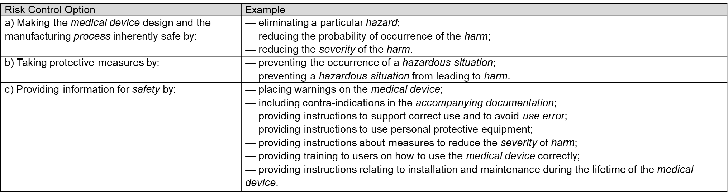
Risk Control
Risk Control Measure types/categories:
Examples from ISO 24971
Notes:
Definitions of what each type of control might entail. More specific examples to follow

Slide 28
Risk Control
Examples of Inherent Safety RCMs:
Description | Example
- eliminating a particular hazard | Eliminating the hazard of sharp edges that can cause injury by designing the surfaces with rounded edges. Eliminating the hazard of electric shock by using a manually operated pump instead of an electrical pump.
- reducing the probability of occurrence of the harm | Reducing the probability of fibrillation harm due to an electric shock by having no accessible live parts. Reducing the probability of unauthorized access to data by identity management. Reducing the probability of biological reactions due to microbial contamination by using cleanroom technologies or sterilization.
- reducing the severity of the harm | Reducing the severity of harm from being squeezed by a moving part by using a low-power motor and low speed. Reducing the severity of harm from an electric shock by using low electric voltage (below 42 V).
Examples from ISO 24971
Examples of Inherent Safety RCMs for use-related hazards:
Option | Examples
Inherent safety by design | • Use specific connectors that cannot be connected to the wrong component. • Remove features that can be mistakenly selected or eliminate an interaction when it could lead to use error. • Improve the detectability or readability of controls, labels, and displays. • Automate device functions that are prone to use error when users perform the task manually.
Examples from IEC 62366-1
Notes:
These are included for reference. Again, standards and TIRs are good sources for controls

Slide 29
Risk Control
Examples of Protective Measure RCMs:
Description | Example
- preventing the occurrence of a hazardous situation | Using automatic cut-off or over-pressure valves. Protective covers of electrical wires and power units (covered plugs, sockets and connectors). Guards for moving parts or to prevent patients falling off a table or out of bed. Inspection testing in manufacturing to detect non-conforming products.
- preventing a hazardous situation from leading to harm | Using visual or acoustic alarms to alert the user to a hazardous situation.
Examples from ISO 24971
Examples of Protective Measure RCMs for use-related hazards:
Option | Examples
Protective measures in the medical device itself or in the manufacturing process | • Incorporate safety mechanisms such as physical safety guards, shielded elements, or software or hardware interlocks. • Include warning screens to advise the user of essential conditions that should exist prior to proceeding with device use, such as specific data entry. • Use alerts for hazardous conditions, such as a “low battery” alert when an unexpected loss of the device’s operation could cause harm or death. • Use device technologies that require less maintenance or are “maintenance free.”
Examples from IEC 62366-1

Slide 30
Risk Control
Examples of Information for Safety RCMs:
Risk Control Option | Example
- placing warnings on the medical device; | Warning: Do not use after [expiry date].
- including contra-indications in the accompanying documentation; | Do not use with neonates.
- providing instructions to support correct use and to avoid use error; | Apply epinephrine injector to the middle of your outer thigh (upper leg), through clothing if necessary. Do not inject into your veins, buttocks, fingers, toes, hands or feet. Hold the leg of young children firmly in place before and during injection to prevent injuries.
- providing instructions to use personal protective equipment; | Use gloves and eyeglasses when handling toxic or hazardous materials.
- providing instructions about measures to reduce the severity of harm; | Rinse immediately with water after contamination with hazardous substances.
- providing training to users on how to use the medical device correctly; | Training program for operators of radiotherapy equipment or for home-use dialysis machines. Note: Operators may be required to certify to training completion.
- providing instructions relating to installation and maintenance during the lifetime of the medical device | Maintenance intervals, maximum expected lifetime, how to dispose of the medical device properly.

Slide 31
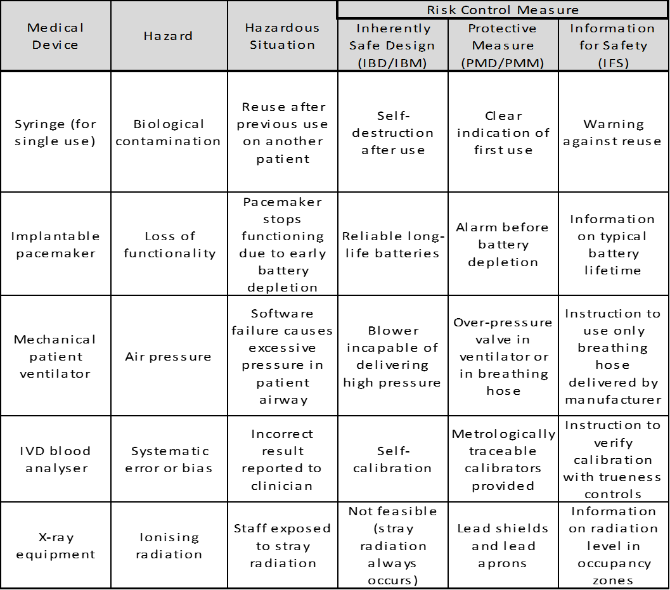
Risk Control
Examples of RCM options for various devices:
Examples from IEC 62366-1
Examples from ISO 24971
Notes:
Examples for reference

Slide 32
Risk Control - Verification
Verification of implementation and effectiveness of the risk control measures:
Objective evidence must be provided to show that all risk control measures have been implemented and that the RCMs effectively reduce risk
Examples of RCM verification of implementation may include design documentation, design specifications, manufacturing process documentation and process qualification
Examples of verification of RCM effectiveness may include design verification, design validation – including usability validation, and manufacturing process validation
Notes:
After risk control measures have been identified they are implemented in the design or manufacturing process and have to be verified to show that they are effective in reducing risk. Note: Design V&V is sometimes used to show VoE but these are different concepts

Slide 33
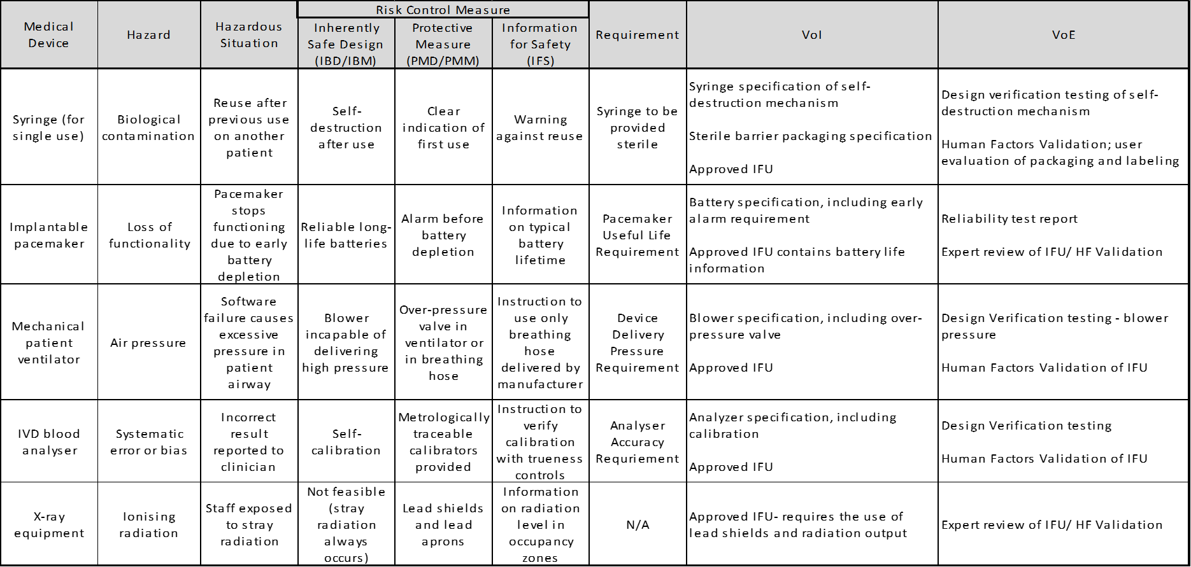
Risk Control - Verification
Verification of implementation and effectiveness examples
Examples from ISO 24971

Slide 34
Risk Control - Residual Risk Evaluation
Residual risk is the risk remaining after risk control measures have been implemented and verified to be effective
The risk is re-estimated and re-evaluated using the same risk estimation and risk evaluation process described in detail above
If a residual risk is not judged acceptable using the defined acceptability criteria, further risk control measures must be considered
If further risk control is not practicable for an unacceptable risk, a benefit-risk analysis must be performed to determine if the benefits of the intended use outweigh the residual risk
If the benefits do not outweigh the residual risk, then the manufacturer may consider modifying the medical device or its intended use. Otherwise, the risk remains unacceptable
Notes:
This is an iterative process

Slide 35
Evaluation of Overall Residual Risk
After all risk control measures have been implemented and verified, the manufacturer shall evaluate the overall residual risk posed by the medical device, taking into account the contributions of all residual risks, in relation to the benefits of the intended use, using the method and the criteria for acceptability of the overall residual risk defined in the risk management plan
Notes:
One more key step – Overall Residual Risk acceptability

Slide 36
Evaluation of Overall Residual Risk (vs. Benefit)
The evaluation of overall residual risk is the point where residual risk is viewed from a broad perspective
Even though all individual risks have been reduced to an acceptable level (or have been accepted based on benefit-risk analysis) from the risk control process step, the overall device risk must be evaluated against the benefit the device provides:
Benefit: positive impact or desirable outcome of the use of a medical device on the health of an individual, or a positive impact on patient management or public health
This step is particularly important for complex medical devices and for medical devices with many individual risks. The evaluation can lead to the conclusion that the medical device is safe and effective – but only if its benefits outweigh its risks
The overall residual risk must be evaluated by persons with the knowledge, experience and authority to perform such tasks. Ultimately, the evaluation should be based on expert judgment with essential roles for application knowledge and clinical expertise
Only when a device’s clinical benefit exceeds its overall residual risk can it be commercialized
Notes:
Requires weighing the totality of risks against the benefits of using the device

Slide 37
Device Risk Management Key Takeaways
ISO 14971 provides the framework for successful medical device risk management. Use it and other applicable standards as a baseline for developing safe and effective devices
Safe and effective for their intended use with their intended users in their intended use environment
All devices have some level of risk. The benefits of using a device must outweigh its risks
Risk analysis and Risk control are key activities for successfully managing device risks
Look to standards and guidance documents as well as readily available real-world data on your device for sources of hazards, hazardous situations, and harms
Involve clinical and medical specialists when assessing harms and severities

Slide 38
Q & A

